Slide 1



Optimising time-limited non-pharmaceutical interventions for COVID-19 outbreak control
Alex Morgan
(Paper currently submitted and undergoing revisions at Phil Trans B)

Slide 2
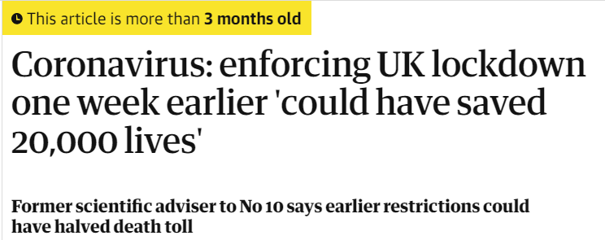
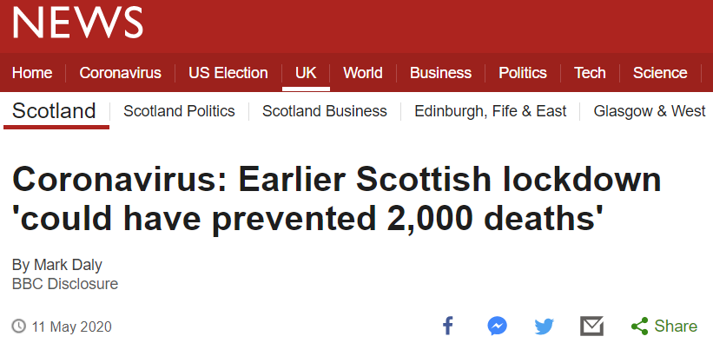
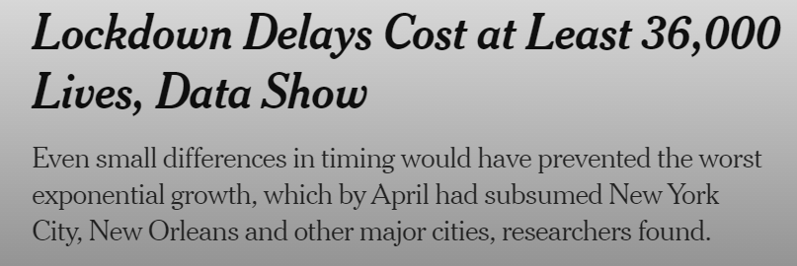
Non-pharmaceutical interventions (NPIs)
Non-pharmaceutical interventions (NPIs)
Mask wearing
Physical distancing
School closures
Travel restrictions
Stay at home orders
“Lockdown” measures are just a package of NPIs.
Can we optimise NPIs?
Notes:
Cut down bullet points
The last bullet point needs to be specified to not just be the introduction of NPIs

Slide 3
NPI Optimisation
Intervention optimisation – finetuning the characteristics of an intervention to minimise the negative human health outcomes of a disease.
Aim of this study
Use mathematical modelling to explore the concept of intervention optimisation across a range of different NPI scenarios.
Notes:
Including the identification of robust intervention measures
What is a robust intervention measure
They only optimised single interventions and didn’t talk about the feasibility etc
Specify detrimental human health outcomes in the definition

Slide 4
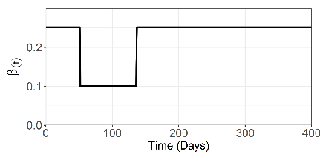
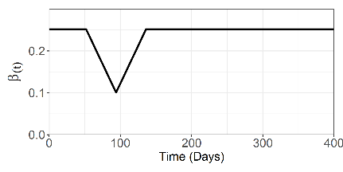
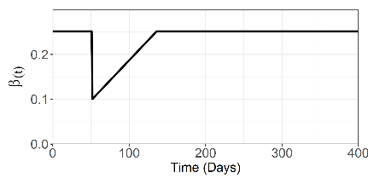
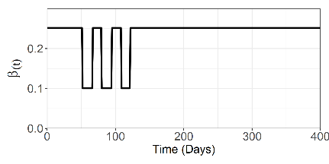
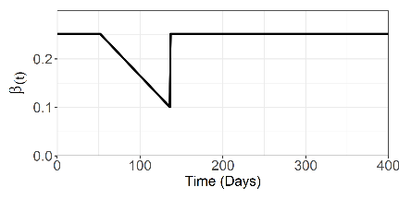
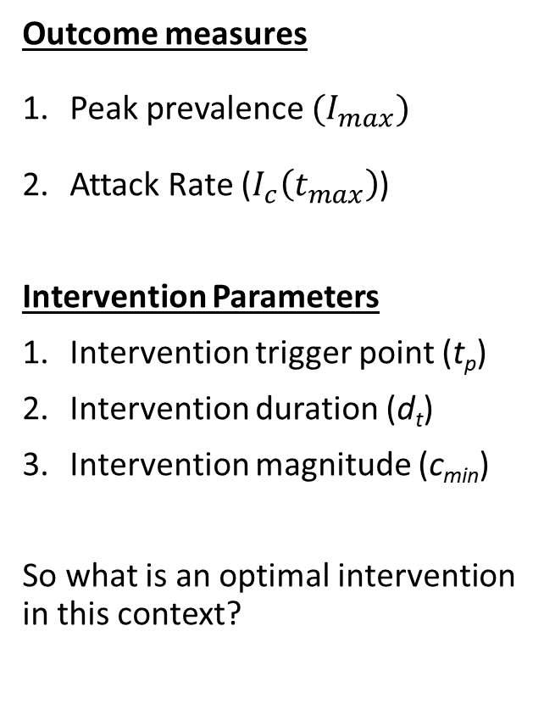
Methods – An optimal intervention
β(t) – time-varying per capita rate of COVID-19 transmission
NPIs will have the effect of reducing β(t)
Outcome measures
Peak prevalence $(I_{max})$
Attack Rate ($I_{c}\left(t_{max}\right)$)
Intervention Parameters
Intervention trigger point (t_{p})
Intervention duration (d_{t})
Intervention magnitude (c_{min})
So what is an optimal intervention in this context?
Scenario 1
Scenario 4
Scenario 2
Scenario 5
Scenario 3
Notes:
Make the parameter definitions a bit more lay
5 scenarios – give examples of what they are and what they entail – spend a bit more time on the slide

Slide 5
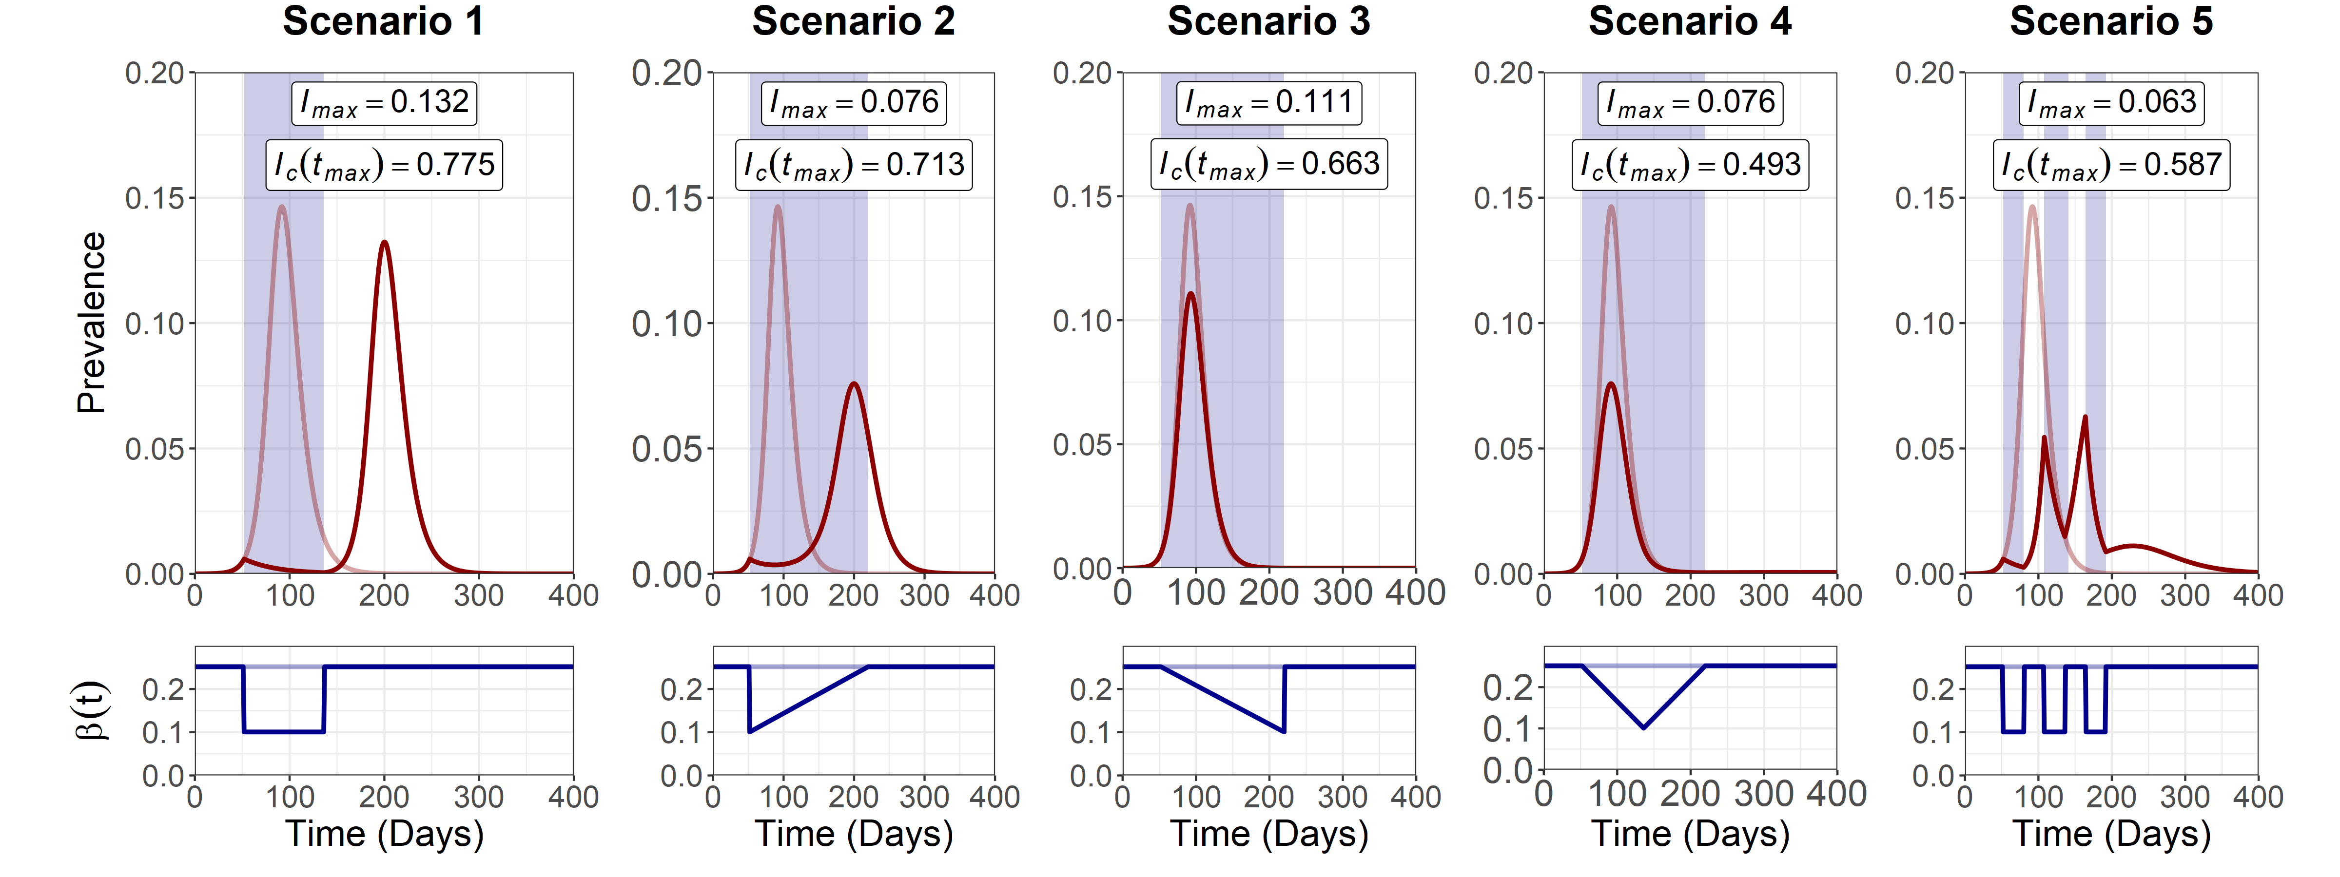
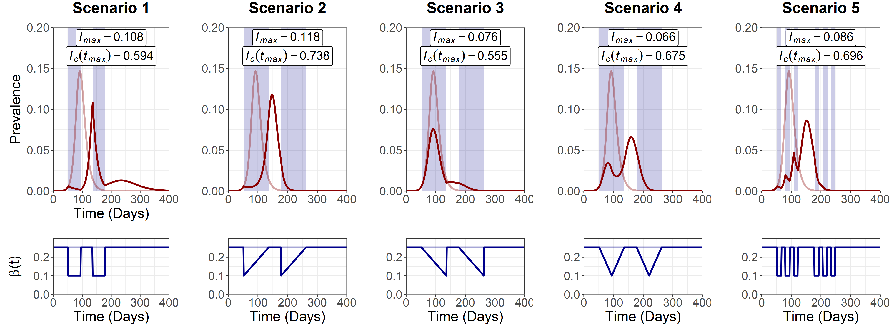
Results – Single and Multiple NPIs
Epidemic Curve
Single Intervention
Transmission Reductions
Epidemic Curve
Dual Intervention
Transmission Reductions
Notes:
Each NPI scenario has a different effect on the prevalence and R_{e}(t). – take home message – due to sdhape of beta t reduction

Slide 6
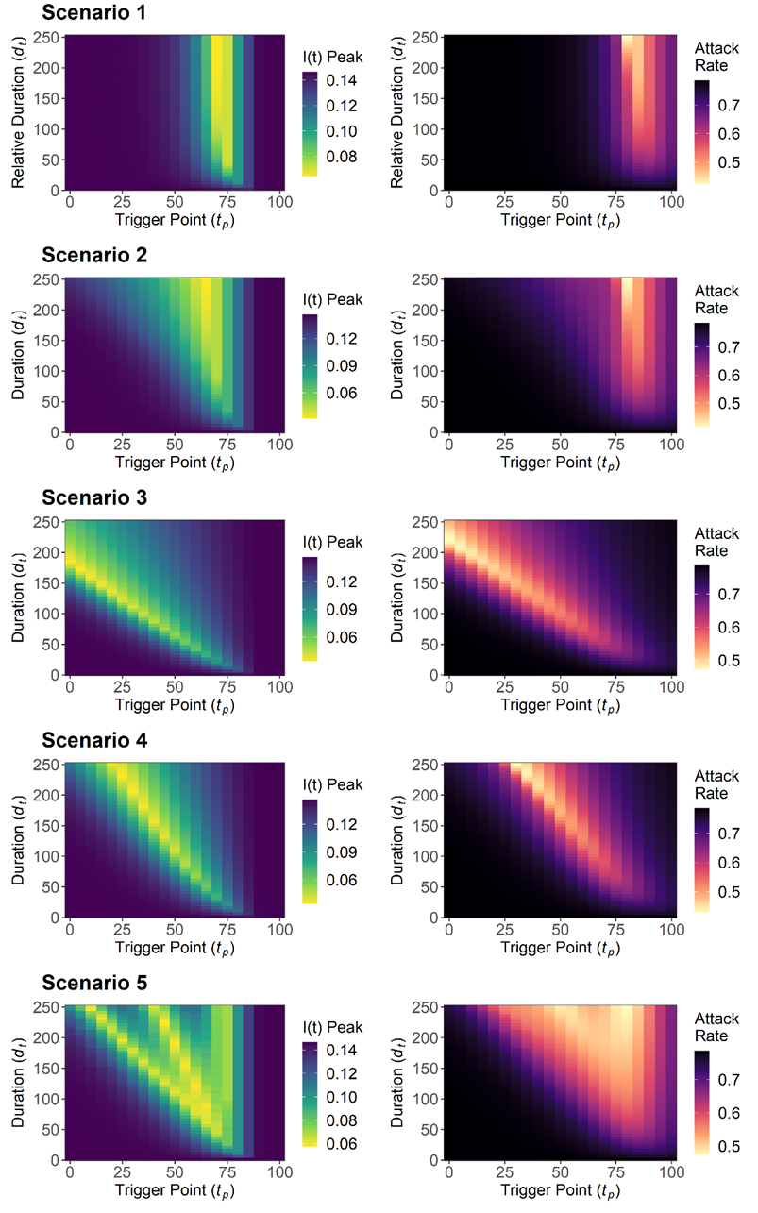
Results – Single NPIs
Identify the optimal parameter space for two parameters:
Duration (d_{t})
Trigger Point (t_{p})
As duration increases, the optimal trigger point becomes more robust to implementation error
If you can’t be optimal – what is the best alternative?
Optimal parameter space differs between the different interventions
Notes:
We use examples for the sensitivity analysis to show the existence of optimisability – we don’t show all of our results
Also often better to be earlier than optimal in this
Maybe cut down and show single example rather than all at once
Use robust and not suboptimal

Slide 7
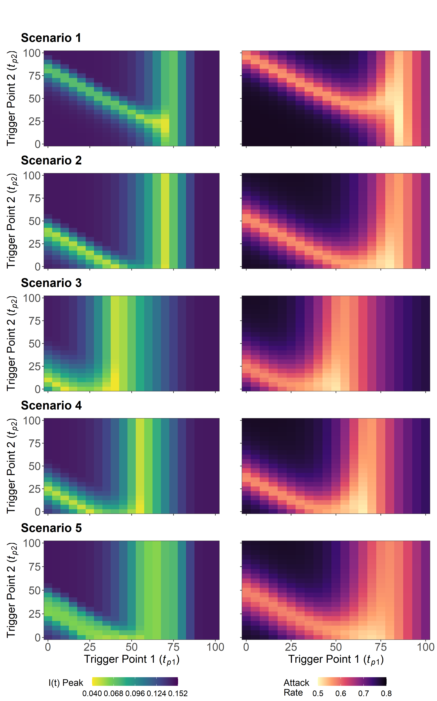
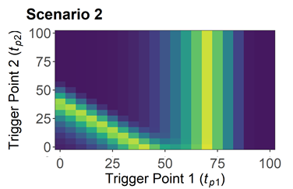
Results – Multiple NPIs
Identify the optimal parameter space for two parameters:
First intervention trigger point (t_{p1})
Second intervention trigger point (t_{p2})
Important to optimise trigger point 1 (t_{p1}) - Although this optimal parameter space is fragile.
Is it better to be earlier or later than optimal?
Better to be earlier-than-optimal with the first intervention (t_{p1})
You can rescue the situation with the second intervention (t_{p2}).
Optimal parameter space is fairly similar across different interventions
Notes:
Speed through it a bit more
Think about compensate as a descriptive word
Be a bit clearer about the axis and what they mean – it changes from last slide

Slide 8
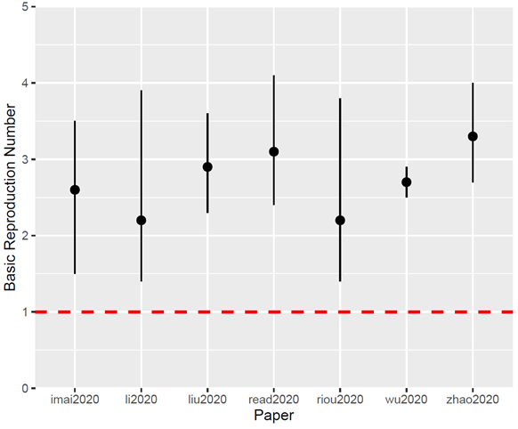
Discussion – Is optimisation possible?
An optimal introduction of an NPI is possible for a range of different interventions
Often not robust to implementation error
Plenty of opportunity for NPI implementation error to occur:
Emerging outbreaks and parameter uncertainty
Varying public compliance.
Imperfect disease surveillance.
Policy miscommunication.
Implementation lag between the introduction of an intervention and the observable effects.
Estimates for R₀ (March 2020)
Notes:
Emerging outbreak scenario – more uncertainty assocaited with these situations – adds to implementation error – expand in a bit more detail

Slide 9
Discussion – A more robust alternative?
Alternative include robust interventions
Less effective than optimal interventions
But less prone to implementation error and more easily achievable
Potentially more useful for policy makers since:
More robust to epidemiological uncertainty.
More digestible messages – i.e: “Hit it hard and fast”
Optimal but fragile
Robust but suboptimal
Notes:
Replace sub-optimal with robust
Keep this a bit shorter

Slide 10
Take Home Messages
NPIs can be optimised to greatly minimise peak prevalence and the attack rate of a COVID-19 outbreak.
But these optimal interventions are fragile, sensitive to epidemiological uncertainty and prone to implementation error.
An alternative is the use of suboptimal interventions as a more robust (but less effective) alternative.
The point of this analysis was not to predict the exact location of the optimal parameter space.
Notes:
While not as effective as optimal interventions, suboptimal interventions are still capable of reducing peak prevalence and attack rate over a wider, more achievable parameter space.

Slide 11


Acknowledgements
Many Thanks to:
University of Edinburgh
Prof Mark Woolhouse
Dr Bram van Bunnik
Hannah Lepper
All of Epigroup
Other
My dogs during lockdown
London School of Hygiene and Tropical Medicine
Prof Graham Medley
Contact Details:
alex.morgan@ed.ac.uk
@Alex_Morgan1995
Funding for this PhD is provided by Wellcome Trust as part of the Hosts, Pathogens and Global Health PhD programme.

